Slide 1
G20:
Need for an inclusive growth agenda
tepav
The Economic Policy Research Foundation of Turkey
Sarp Kalkan
Moscow - December 11, 2012

Slide 2
Framework
What do we understand from inclusiveness?
Key issues from the G-20 perspective regarding inclusiveness
  Globalisation & convergence: Is deindustrialisation a harmful trend?
  Trade Complementarity: South-South cooperation lacking
  Trade baskets and routes designed for developed countries
How to make use of G20? Need for an inclusive growth agenda?
  One proposal: Getting emerging countries’ SMEs together
Concluding remarks

Slide 3
Inclusiveness: a general definition
Equality of opportunities
  Firm size, gender, socio-economic groups etc.
Access to job opportunities
  Skills and capabilities
Entrepreneurship
  Opportunity to take risks
Geography and location
  Connectivity potential
Effective social safety nets

Slide 4
Inclusiveness: from G-20 perspective?
Equality of opportunities
  Firm size, gender, socio-economic groups etc.
Access to job opportunies
  Skills and capabilities
Entrepreneurship
  Opportunity to take risks
Geography and location
  Connectivity potential
Effective social safety nets

Slide 5
A side effect of globalisation: de-industrialisation
Average
Average

Slide 6
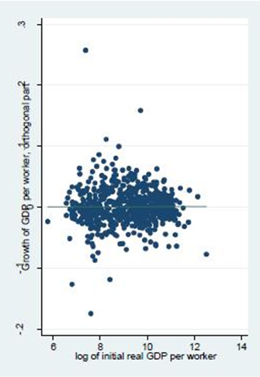
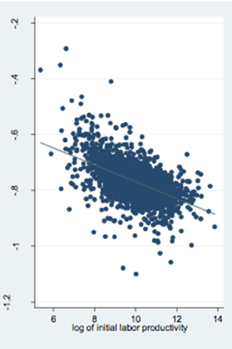
Deindustrialization: harmful for convergence
Only rule: countries boost their productivity only if they are in manufacturing.
Uncondtitonal growth in productivity
Overall Economy
Manufacturing
Source: Dani Rodrik, 2011, The Future of Economic Convergence

Slide 7
Trade complementarity:
Missing among emerging markets

Slide 8
Trade complementarity:
Missing among emerging markets
32
37
51
58

Slide 9
Export baskets mostly designed towards the ‘north’

Slide 10
Export baskets mostly designed towards the ‘north’
USA | 60.6
Mexico | 56.9
Germany | 56.5
EU | 54.3
Australia | 53.0
China
Indonesia | 40.0
S. Korea | 39.6
S. Arabia | 39.2
Turkey | 38.9
India | 30.5

Slide 11
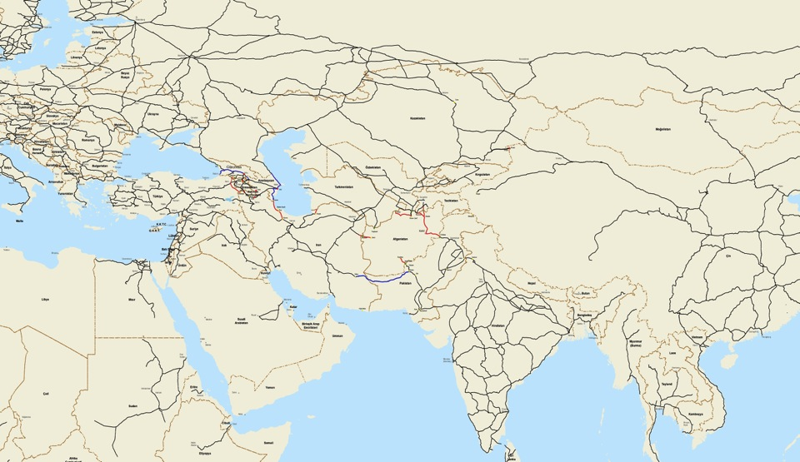
Even trade routes are designed accordingly
How would you ship your cargo from Istanbul to Karachi or Mumbai?
Shipping liner service
Container train railroad
Istanbul
Tehran
via Rotterdam
Islamabad
Karachi
Dhakka
Mumbai

Slide 12
So what?
Trade complementarity is low among emerging countries, largely due to low FDI flows between them
FDI is low due to low connectivity
Need to think of about alternative transportation modes
  FDI flows: MNCs or SMEs

Slide 13
How to tailor G-20 agenda toward more inclusiveness?
Big issues?
  Focus on re-industrialziation
  Focus on connectivity
  Focus on entpreprenuship (women and youth)
A workable program?
  SME internationalization
    not led by MNEs, but a coordinated effort to include SMEs
    Based on a value chain approach

Slide 14
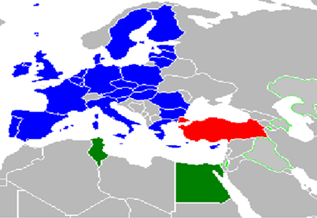
An example: Global Business Bridges Initiative
Coordinated by EU Delegation, Ministry of Economy and TOBB. Feasiblity Study carried out by TEPAV
A new policy tool: Building SME value chains
  Identification of synergies & opportunities
  Finding the right SMEs
  Networking and match-making
Uniting SMEs around a final product
1st phase: Tunisia, Egypt, Palestine

Slide 15
A new role for G20:
Coordinating SME internationalization
A new program could be designed to do the following:
Identifying the appropriate value chains
Finding the right SMEs
Inviting complementary actors
Utilizing incentives and relevant support schemes
Initiating policy dialogue at the value chain level

Slide 16
Concluding remarks
Even if there will be no crisis agenda, global economy will need more policy coordination
  Deindustrialization is a harmful trend for convergence
  Emerging markets are not connected to each other
A new and permanent agenda for G20
  Increasing South-South connectivity
  SME internationalization and Value Chain coordination

