Slide 1
Strategies for Reinvigorating Global Economic Growth
Rajat Kathuria
Director & Chief Executive
ICRIER, New Delhi

Slide 2
Introduction
Global Economic Growth Outlook
Achievements of G20 and Impending Challenges
  Financial Sector Regulation
  Reforming International Monetary system
  Coordinating Global Macroeconomic Policy
    Monetary policy
    Austerity vs. Stimulus
Can Emerging Market Economies (EMEs) be the New Growth Pole?

Slide 3
Global Economic Growth Outlook
No significant upturn in the offing: the latest WEO forecasts only a gradual strengthening of global economic activity.
Global growth is projected at 3.3 per cent and 3.6 per cent in 2012 and 2013, respectively.
The US economy is performing better than its G7 peers. It is projected to grow by 2.2 per cent in 2012 and 2.1 per cent in 2013.
Real GDP growth in the Euro Area to decline by 0.4 per cent in 2012.
  The core economies are expected to see a positive but low growth throughout 2012
  The periphery is likely to suffer contraction in 2012 though will begin to recover in 2013
Emerging and developing economies to grow at 5.3 per cent in 2012 and at 5.6 per cent in 2013.
  The spillovers from the advanced economies—weak demand and uncertainty from insufficient response to the challenges by policy makers—along with country-specific factors have slowed GDP growth in emerging economies.

Slide 6
Financial Regulation
The G20 has made substantial progress on financial sector reforms—especially on
  Endorsing the Basel III framework for improving the quality and level of capital, liquidity and capital buffers, and reducing leverage
  Measures to indentify global SIFIs (G-SIFIs), framework for better resolution and supervision, and supplementary prudential requirements for increasing their loss absorbency capacity; extending this framework to domestically significant banks, non-banks and insurance companies
  Mandating all trading of standardized OTC derivatives on exchanges or on electronic trading platforms, clearance through central counterparties (CCPs) and reporting to trade repositories (TRs)
However, recent studies show that
  Enhanced capital and liquidity buffers have beneficial effects on emerging market economies; however, their effect is not significant for advanced economies as magnitude and quality of buffers are insufficient (GFSR, 2012).
  Though financial buffers are generally beneficial, beyond certain levels they tend to lower economic growth, and increase output volatility and financial stress (GFSR , 2012)

Slide 7
Financial Sector Vulnerabilities
Several unresolved short-term issues are weighing down on the global financial markets:
  Risks remain elevated due to the inability of advanced economies to effect credible fiscal consolidation plans, recession in the Euro area and slowdown in emerging economies.
  Slowdown in the global economy, which further deteriorates the balance sheet of financial institutions and sovereigns
  The lack of consensus on direct recapitalization of banks in Europe and on introducing a banking union has increased the risk perception
  One of the immediate concerns is the looming ‘Fiscal Cliff’ in the US.
  However, uninterrupted recovery of US housing markets in the past two quarters is one of the few positive developments for financial markets.
An assurance to “buy an unlimited amount of Euro zone sovereign debt” by the European Central Bank under the outright monetary transactions (OMT) has lowered the risk perception in peripheral Euro area countries.
  The bond yield on Spain and Italy has declined sharply post OMT announcement.
  Credit default swap (CDS) on Spanish, Italian and Portuguese sovereign bonds declined.

Slide 10
Concerns of EMDEs
  The G20 finance ministers also initiated a study to understand the unintended consequences of these reforms on emerging market and developing economies (EMDEs).
  The concerns of the EMDEs are
    First, many of these reforms may have negative spillover effects on EMEs which may reduce credit and liquidity, and hence raise the cost of intermediation: for example,
      Basel III capital requirements may lead to cutting of global banks’ operation in EMDEs;
      Higher norms for G-SIFIs may disproportionately affect their operations in EMEs.
    Second, the reform initiatives do not take the state of economic, financial development, and the extent of financial market regulation: e.g. for a credit-starving emerging economy like India, which has a well capitalized and tightly regulated financial markets, these reforms would increase the cost of capital further without adding to financial stability.

Slide 11
Minimum Regulatory Capital Prescriptions
(as percentage of risk weighted assets)
 |  | Basel III (as on January 1, 2019) | RBI’s Prescriptions
 |  |  | Current (Basel II) | Basel III (as on March 31, 2018)
A = (B+D) | Minimum Total Capital | 8.0 | 9.0 | 9.0
B | Minimum Tier 1 capital | 6.0 | 6.0 | 7.0
C | of which: Minimum Common Equity Tier 1 capital | 4.5 | 3.6 | 5.5
D | Maximum Tier 2 capital (within Total Capital) | 2.0 | 3.0 | 2.0
E | Capital Conservation Buffer (CCB) | 2.5 | - | 2.5
F = C+E | Minimum Common Equity Tier 1 capital + CCB | 7.0 | 3.6 | 8.0
G = A+E | Minimum Total Capital + CCB | 10.5 | - | 11.5
H | Leverage Ratio (ratio to total assets) | 3.0 | - | 4.5
Source: Subbarao, 2012

Slide 12
Additional Common Equity Requirements of
Indian Banks under Basel III
(INR Billion)
 |  | Public Sector Banks | Private Sector Banks | Total
A | Additional Equity Capital Requirements under Basel III | 1400-1500 | 200-250 | 1600-1750
B | Additional Equity Capital Requirements under Basel II | 650-700 | 20-25 | 670-725
C | Net Equity Capital Requirements under Basel III (A-B) | 750-800 | 180-225 | 930-1025
D | Of Additional Equity Capital Requirements under Basel III for Public Sector Banks (A)
 | Government Share (if present shareholding pattern is maintained) | 880-910 | - | -
 | Government Share (if shareholding is brought down to 51 per cent) | 660-690 | - | -
 | Market Share (if the Government’s shareholding pattern is maintained at present level) | 520-590 | - | -
Source: Subbarao, 2012

Slide 13
Reforming International Monetary System (IMS)
Despite increased resources at the hands of the IMF and new credit facilities, emerging and developing economies continue to accumulate foreign exchange reserves to deal with economic crises, indicating the limitations of IMF resources vis-à-vis growing global trade and financial integration, and the stigma attached to borrowing from the IMF.
Apart from accumulation of reserves, countries have entered into bilateral credit line and regional financial safety-nets like Chiang-Mai Initiative and EFSF/ESM.
Although IMF has streamlined conditionalities in its lending facilities, more needs to be done to reduce the hardship from demand compressing requirements and stigma attached with it for countries accessing IMF facilities.
IMF introduced new facilities for European countries recently; the effectiveness of IMF facilities were not tested because of the nature of the Euro crisis and center of the crisis (mainly in reserve currency countries).
However, considerable progress has been made in IMF governance, especially in quota and voice reforms
  Call for quota and governance reform in IMF at G20 Seoul
  At 14th General Review of Quotas, which is yet to be approved by the member countries
    Would double quotas
    Shift more than 6 percent of quota shares to EMEs which would realign quota shares and bring in 4 EMEs to the top 10 shareholders, while preserving the quota and voting share of the poorest member countries

Slide 14
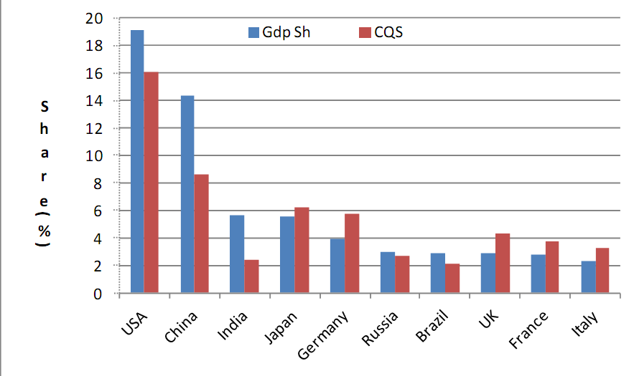
IMF Quota Share
Note: GDP Sh = Share of aggregate World production in 2011; CQS = Calculated quota share
Source: Virmani, 2011

Slide 15
Coordinating Monetary Policy
According to Ben Bernanke, QE has resulted in significant decline in yield on long-term Treasury, corporate bonds and MBS. The first two rounds of LSAPs, may have raised the level of output by almost 3 per cent and private payroll employment by more than 2 million jobs, relative to what would have occurred otherwise (Bernanke, 2012).
However, other independent estimates show negligent effect of QE on the US economy.
In Europe, loose monetary policy has provided breathing space by reducing the borrowing costs for sovereigns and funding constraints for financial institutions. So far, loose monetary policy has not translated into increased lending to the real economy.
Potential impacts: Ultra easy monetary policies may
  threaten the health of financial institutions and the functioning of financial markets
  encourage imprudent behavior all around
  threaten the “independence” of central banks (White, 2012)
  Impose potential costs of purchasing distressed assets on central banks
Impact on the rest of the world
  Excessive financial flows to the EMEs; the "monetary tsunami"
  Artificially depresses dollar and boosts US exports

Slide 17
Austerity vs. Stimulus
After 2008 Global Financial Crisis, the public debt in advanced economies has exploded due to loss of revenue and increase in expenditure.
Double dip recession and rising debt in Euro area has led to a heated austerity vs. stimulus debate
Critics of austerity program cite its contractionary effects on the European economies. It not only lowers the economic growth, but also reduces the revenue of the governments defeating the objective of fiscal consolidation.
However, opponents of stimulus worry about indebtedness, moral hazard and crowding-out (Corsetti 2012).
A recent IMF study shows that the fiscal multipliers could be between 0.9-1.7 during recessions as against the prevalent assumption of 0.5; hence, the fear of crowding-out may be misplaced (IMF, 2012).
The study also finds that the tighter the fiscal policy the slower the GDP growth of G20 advanced economies during the current crisis.

Slide 18
Fiscal Sustainability: What Needs to be Done
‘Fiscal Cliff’ in the US may restore the debt and deficit at sustainable levels, however, it would push the US economy into recession. Hence, the US should avoid the cliff.
However, given the rebound in economic growth, the US can put an effective fiscal consolidation plan.
Fiscal austerity has become a self-defeating goal in the Euro area. They should shift their focus from austerity to short-term recovery and job creation.
India should rationalize the subsidies to reduce the fiscal deficit. It will improve the investor sentiment and push economic growth.

Slide 19
Select Debt Indicators for India

Slide 20
Emerging New Growth Poles
The group of six major emerging market economies (EMEs)—Brazil, China, India, Indonesia, South Korea, and Russia—is predicted to be the next growth pole driving global economic growth.
However, in the current scenario, the growth model of some these successful EMEs—technological adaptation and reliance on export mainly fueled by advanced economies—may not be sustainable.
Need for new source of global growth.
The new growth poles should look inward and rely more on productivity gains and robust domestic consumption demand.
The outlook for domestic consumption-driven growth from the EMEs look optimistic given demographic transitions in EMEs.
This would help recovery in advanced economies by boosting their exports.

Slide 21
New Growth Poles...
Source: World Bank, 2011

Slide 22
New Growth Poles...
G20 may play a crucial role in the transition process:
More integration and new centers of economic power would bring in new challenges for economic diplomacy and coordination.
G20 may play a decisive role in coordinating global economic policy making, managing financial and trade integration, and developing appropriate policy and institutional responses (IFI governance) to promote global growth and reduce economic instability.
Key areas for G20 collaboration
Infrastructure investment will
  reduce supply constraints in EMEs and promote global demand as infrastructure is import-intensive
  Require innovative new financing mechanisms: MDBs and BRICS Bank
Trade
  Boosting global trade further by finding a solution to Doha standoff

Slide 23
Conclusion
World economy is struggling to revive the economic growth. The fiscal and monetary policy space for stimulating growth is very limited in advanced economies because of stretched balance sheets of governments and central banks.
Spillover from advanced economies has affected the economic growth in emerging market economies (EMEs); nevertheless, they are still growing at healthy rate. If EMEs resolve their domestic problems, they can attain the high growth trajectory and become engines of growth for the world economy.
Risk aversion in the financial market has declined in recent months; however, several unresolved issues are weighing down on the markets.
G20’s push for Basel III is an important step in making the global financial system safe, however, it needs to address the concerns of well regulated and credit starved countries like India.

Slide 24
Thank you

