Slide 1
THE SHIFTING GEOGRAPHY OF GLOBAL VALUE CHAINS: IMPLICATIONS FOR Trade policy
WEF Global Agenda Council on the Global Trade System
Presentation by Peter Draper, vice-chair
And Senior Research Fellow
South African Institute of International Affairs

Slide 2
OVERVIEW
The ‘task’ perspective
Associated policy paradigm
Broader implications
Key takeaways for the G20

Slide 3
The ‘task’ perspective

Slide 4
Shifting geographic concentration of manufactured exports: Triad plus east Asia
Source: Baldwin and Lopez-Gonzales

Slide 5
Driven by TNCs, which account for some 80% of global trade now - nearly half governed in GVCs
Global trade (exports of goods and services), by type, 2010, $ Trillions
ESTIMATES
~19
~4
Total TNC-governed trade: ~80%
~15
~6.3
~2.4
~6.3
Global trade in
Non-TNC trade
All trade under
governance of TNCs
Intra-firm trade
NEM-generated trade
TNC arm's length
goods and services
trade
Source: UNCTAD estimates, based on WIR12 (table I.8); BEA; EFIGE.

Slide 6
FDI drives value chains, particularly into emerging markets which are also becoming significant investors
Share of developing and transition economies in global flows, 2000-2012
(Per cent)
60
Inflows
Outflows
50
40
30
20
10
0
2000
2001
2002
2003
2004
2005
2006
2007
2008
2009
2010
2011
2012:
H1
Source
: UNCTAD, FDI/TNC database.

Slide 7
This is a world of trade in tasks, raising many governance issues
Source: Sourcemap

Slide 8
Promoting manufacturing: ‘Task perspective’
Shifting geography of global value chains creates opportunities for developing countries
Drivers:
  Resource cost pressures (energy; transport; carbon abatement; competition; export restrictions)
  The ‘China price’ (wages; land; domestic demand)
  Declining IT costs (competition)
  Shifting demand (European stagnation; emerging market growth)
How will these drivers combine to drive value chain relocations?
What needs to be done to benefit?

Slide 9
Promoting manufacturing: ‘Task perspective’
  Developing countries/companies should aim to plug in to and develop competitive advantage in specific ‘tasks’ rather than drive the value chain per se
  Then aim to move up the value chain in time
  Fundamentally it is about niches and broadening the division of labour, or increasing specialization

Slide 10
Associated policy paradigm

Slide 11
Address an array of border and behind the border barriers
TRADE CHAINS
EXPORTING COUNTRY
IMPORTING COUNTRY
To the border
At the border
Behind the border
Infrastructure
Soft
Hard
Costs
Direct
Indirect
Hidden
Regulations
Institutions
Service
TRANSPORT
Source: OECD

Slide 12
Task Perspective: Policy Paradigm
Reduce transactions costs in order for factors of production and products (tangible and intangible) to flow more freely
Invest in horizontal policy measures to promote inward investment and trade
Strengthen domestic governance and institutions to promote favourable investment climate
The G20 should support these objectives by retaining and deepening its development focus

Slide 13
Task Perspective: Policy Paradigm
Several dimensions:
  Unilateral liberalization
  Modernizing WTO rules
  Preferential trade agreements
With broader implications:
  Trade balances
  Exchange rates

Slide 14
Unilateral liberalization
Host country attractiveness to FDI in manufacturing is critical
Value chains are driven by trade in intermediate products
Therefore imports are as important as exports, sometimes more so

Slide 15
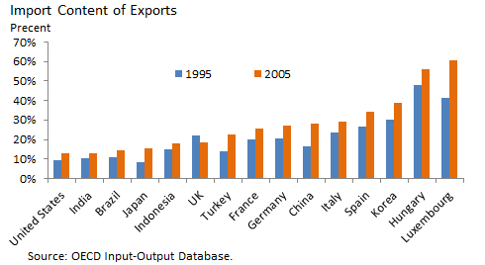
Intermediate product trade
With exception of the UK (finance centre) imported intermediates have consistently increased for OECD countries

Slide 16
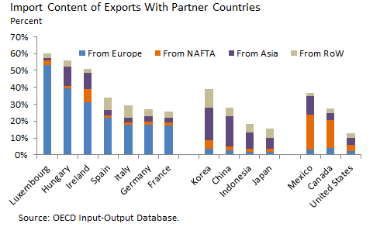
Proximity to one of the triad economies matters
This implies developing countries need to be more open to FDI and trade since we are equally far from the triad economies and our immediate neighbours don’t have much to offer beyond resources

Slide 17
Unilateral liberalization
Many services support manufacturing activity and need to be available on location or be easily accessible at affordable prices
  Network services are particularly important (energy; finance; telecommunications; transport)
  A range of others matter a great deal (eg: professional; education; logistics; distribution; etc.)
Such services are often best provided on location, meaning openness to FDI is important
Scholars are now researching services value chains as value chains in their own right, increasingly independent of manufacturing and containing higher value-added activities

Slide 18
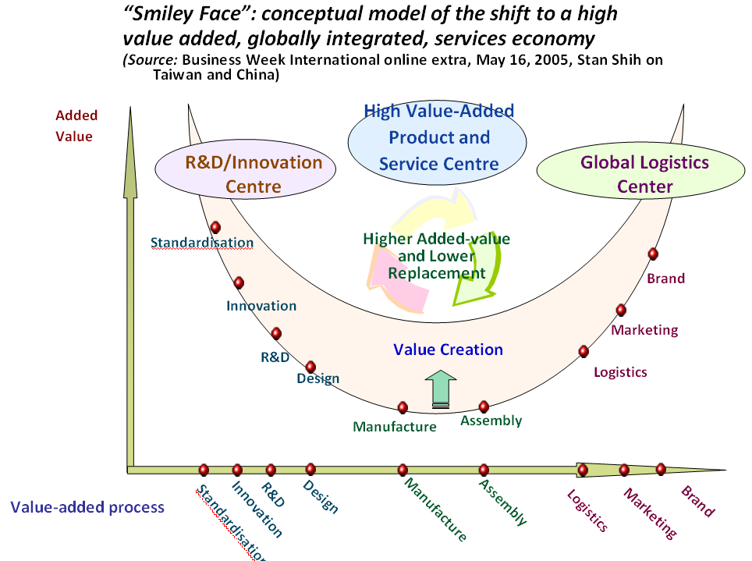
Services value-added in relation to manufacturing

Slide 19
Modernizing the WTO
The WTO’s rules architecture is outdated in key respects
  Coverage of FDI is patchy and not systematic
  Services are incompletely covered
  It is still very easy for governments to shut out foreign imports, for example through recourse to trade remedies
Since the WTO is stalemated, the best way to fix the problem is through small group negotiations or ‘plurilaterals’ - perhaps the G20 could pioneer new approaches?

Slide 20
Preferential trade agreements
Value chains are more intense at the regional level, particularly in dynamic regions
Trade rules can advance more rapidly through PTAs than in the WTO
However the patchwork of PTAs adds to transactions costs and could undermine operation of global value chains
Especially rules of origin – the more detailed and inward-looking they are, the more they impact on value chains
Therefore multilateral rules are the first best option
However, the growth of PTAs, especially ‘mega-regionals’, threatens to marginalise the WTO

Slide 21
Broader implications

Slide 22
Broader implications
Importance of exports overstated, while importance of trade as driver of efficiency is understated
Trade is now more volatile and a larger source of shocks
The cost of protection is higher, and rising

Slide 23
Broader implications
Traditional view of trade balances is hopelessly outdated
This has major implications for policy positions, particularly with respect to advanced countries
And for associated exchange rate discussions, especially concerning China
This has obvious relevance to the G20’s macroeconomic coordination agenda

Slide 24
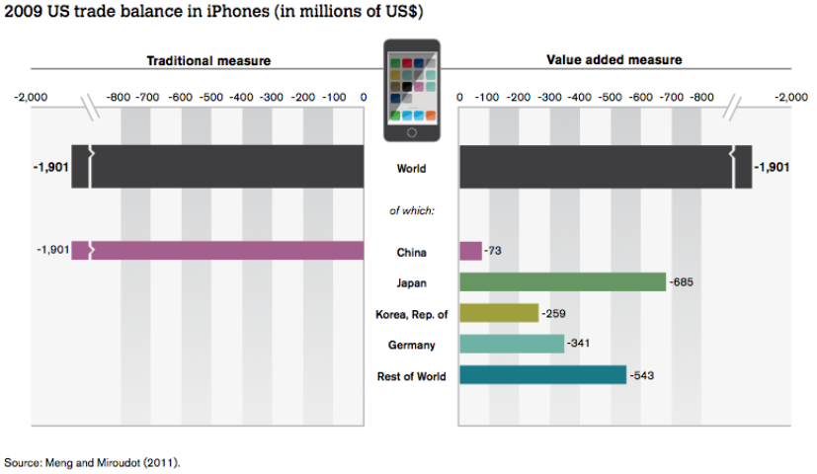
Rethinking Bilateral Trade Balances

Slide 25
Key takeaways for the g20

Slide 26
Key takeaways for the G20
Emerging markets have a strong interest in GVCs – as recipients but increasingly as sources
An appropriately framed G20 development agenda could widen this circle
Therefore there is an increasingly shared interest in multilateral rules relevant to GVC governance
However, the WTO is stalled, if not dead
And the growth of PTAs threatens to render it irrelevant
So at the very least the G20, as the self-appointed ‘apex group’ steering global economic governance, needs to seriously address these systemic challenges

Slide 27
Key takeaways for the G20
Progress will depend on:
  Carving out a meaningful package from the DDA
  One that provides LDCs with something substantial, thus buying sufficient trust for a thrust on GVC-related plurilaterals
The next phase in the evolution of the WTO comes down to establishing GVC-related rules
Therefore the G20 should seed and strongly support this process since the politics are very challenging

