Slide 1
The G20 and Development
Barry Carin
Senior Fellow
Centre for International Governance Innovation
December 11,2012

Slide 2
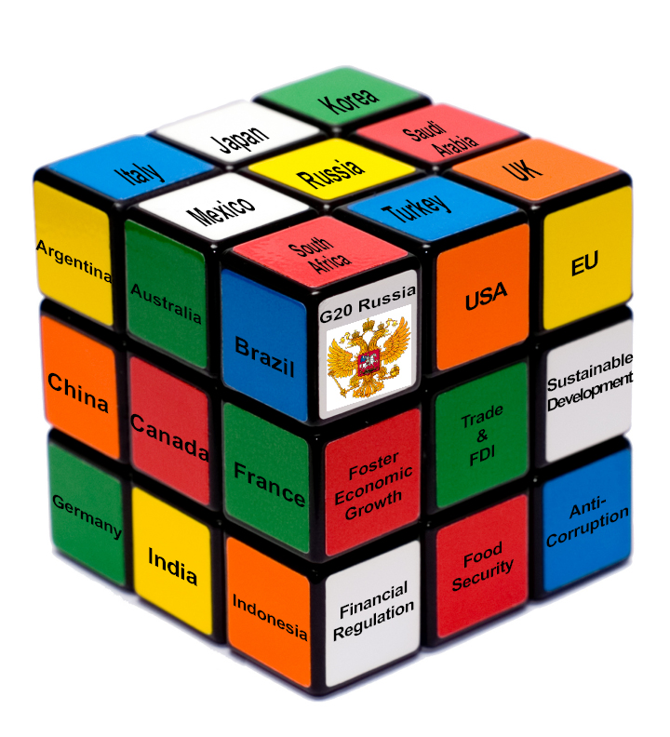

Slide 3
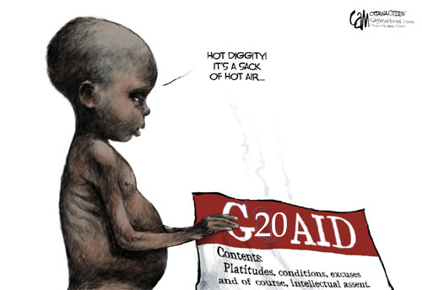
Canadian View

Slide 4
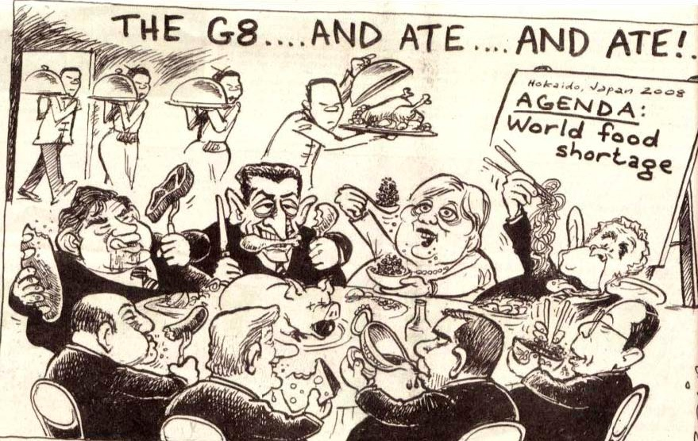
South African View

Slide 5
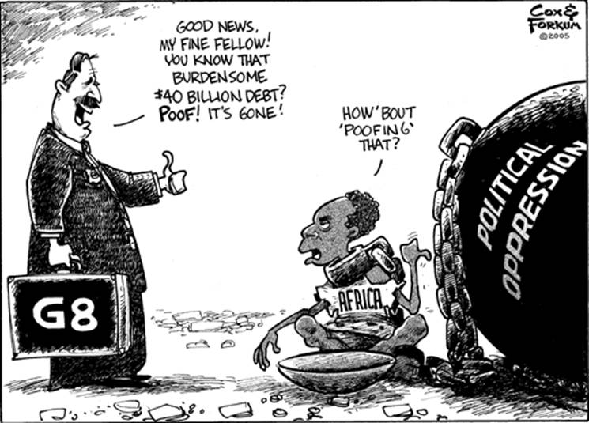
Political oppression
U.S.A View
G20
Notes:
Change G8 to G20

Slide 6
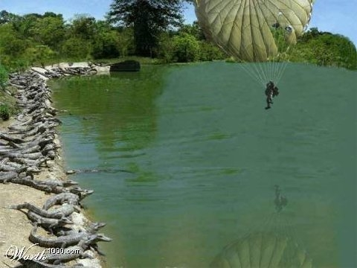
G20 must find its niche in a crowded space
UNDP
UNICEF
UNEP
UN Women
UNFPA
WHO
DESA
ILO
FAO
UNCSD
MDB’s
Civil Society
Donors
G20
X
Notes:
The G20 must find its niche in a crowded global development architecture, where UN bodies, MDBs and the donor community all jealously guard their prerogatives.

Slide 7

Focus on Growth and Institutional Reform
Deliver on existing commitments
Focus on coherence
Contribute to the successor framework to the MDGs
Launch a program to collate and promote “winning ideas”

Slide 8

1.Deliver on Existing
Commitments (1)
Project Preparation Facilities
Construction Sector Transparency Initiative
“Sokoni Africa Infrastructure Marketplace” platform and the global infrastructure benchmarking initiative
MDBs credit-enhancement tools
Strengthening of local financial intermediaries
Fossil fuel subsidies
Remittances
Notes:
Where does definition of ``development`` end? Food security and commodity price volatility both have connections to FSB agenda. Infrastructure investment? Financial inclusion and microfinance? Sustainable Development- climate change / green growth / sustainable development, climate change financing? Is it about low-emission development?

Slide 9
1. Deliver on Existing
Commitments (2)
Nine pillars of Seoul Development Consensus
1) infrastructure
2) private investment and job creation
3) human resource development
4) trade
5) financial inclusion
6) resilient growth
7) food security
8) domestic resource mobilization
9) knowledge sharing
Notes:
Where does definition of ``development`` end?Food security and commodity price volatility both have connections to FSB agenda. Infrastructure investment? Financial inclusion and microfinance? Sustainable Development- climate change / green growth / sustainable development, climate change financing? Is it about low-emission development?

Slide 10
2. Focus on Coherence
Strengthen international organizations and informal arrangements.
  Food Security: Coordinate biofuel policies, regulation of derivative markets, agriculture market distortions, rural infrastructure, and research and investment
  Integrate Agriculture and Finance solitudes
  Migration, the interface of water resources with trade (link of water and agriculture), and food security.
  Coordinate development policies in infrastructure, agriculture and climate
  Connect funding infrastructure to protocols on transparency and corruption
Do not depreciate the G20’s reputation with repetitive fruitless proclamations of renewed commitment to the doomed Doha Round
  Commission reports for mandates re global governance gaps.
Notes:
Catalyze work to modernize governance arrangements.
Commission reports for mandates re global governance gaps that militate against sustainable and balanced growth.
Informal arrangements in delivering food security beyond reform of the Committee on World Food Security
Avoid headline like Los Cabos “G20 fails 1 billion hungry people worldwide: Development and food security sidelined”
Connect funding infrastructure to protocols on transparency and corruption (to avoid fiascos like the World Bank in Bangladesh)

Slide 11
3. Contribute to Post-2015 MDGs
Goals influence behaviour, priorities, and investment.
UN consultation process - Consensus unlikely
Pressure re poverty; employment; inequality; social protection; food security; health; secondary/tertiary education; security; gender; disaster resilience; connectivity; “energy for all”; human rights; environmental sustainability; climate change; anti- corruption; governance.
G20 could mediate.
Notes:
A core group of representatives from major countries will have to broker a deal
Address relative gaps and inclusive growth
Landmines; diseases.

Slide 12
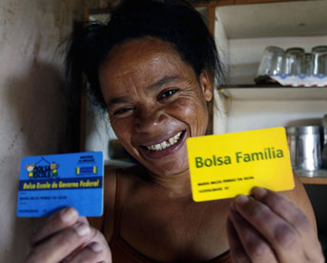
4. Launch a Program to
Promote Winning Ideas
Advance Market Commitments
Progress based aid
Conditional cash transfers
Inter-jurisdictional competitions
MIT Poverty Action Lab – Smart subsidies
Peer review programs
Tax incentives
Remittances facilitation
Micro finance

