Slide 1

L20 Launch BEIJING
1 FEBRUARY 2016
John EVANS
Tuac/Ituc

Slide 2
L20 STANDING OBJECTIVES:
“REBUILDING ECONOMIES
JOBS AND WAGES”
  Support jobs and stimulate growth
  Reduce income inequality
  Support development
  Re-regulate financial markets
  Have unions at the table
  These are all still relevant in 2016

Slide 3
Looking back at the Antalya Summit Outcomes
G20 Policy Priorities on the labour income share and inequalities
Target to reduce the number of young people excluded from jobs or training by 15% by 2025
G20 Framework on Promoting Quality Jobs
Adoption of the BEPS Action Plan
B20-L20 Agreement (25by25 target, digital economy & apprenticeships)
Joint Finance & Labour Ministerial & social partners’ inclusion (social dialogue recognized in Antalya communiqué)

Slide 4
Looking back at the Antalya Summit Outcomes
Disproportionate voice given to B20 at the Summit, need more parity
G20 growth target undershot, no timely implementation
Need for an infrastructure & wage recovery policy package
Prioritization and execution processes for public-private-partnerships (PPP), support for “Inclusive business” in development
Failure to address social standards in GVCs (esp in comparison to the G7)

Slide 5
Looking back at the Antalya Summit Outcomes
National investment strategies
G20 Skills Strategy
Refugee paragraph

Slide 6
The Brisbane Legacy
800 new policies
2.1% growth target by 2018
G20 Action Plans on taxation/ investment/ female employment & safer workplaces

Slide 7
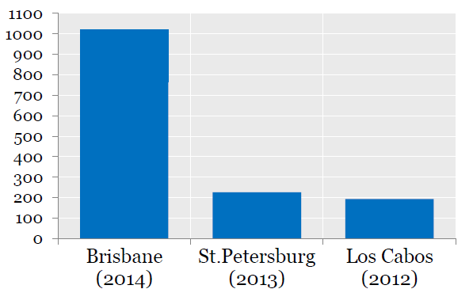
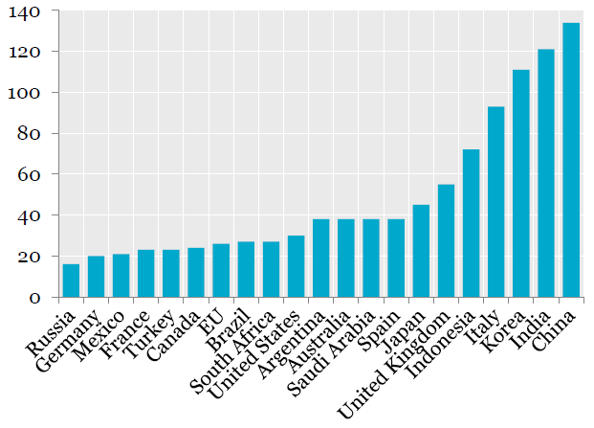
G20 Growth Strategies and Employment Plans
Number of policy commitments
Number of policy commitments
Submitted as part of the Brisbane Action Plan
Progress towards raising the level of their combined GDP by 2.1 percent by 2018 relative to Oct 2013 baseline projections
Close to 1000 individual structural policy commitments, of which more than 800 are new
More than ½ of commitments is related to infrastructure (26%) or jobs (30%)

Slide 8
Meanwhile, the situation on the ground gets worse:
Projections of economic growth revised downwards – again! (IMF & OECD)
On unchanged policies the jobs gap continues to rise and by 2019, more than 212 million people will be out of work, up from 201 million in 2014
Almost 74 million young people, aged 15–24, were looking for work in 2014
Especially young women, continue to be disproportionately affected

Slide 9
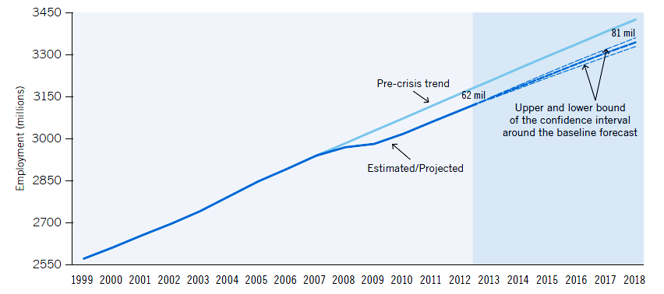
The “jobs gap” will continue to rise until the end of the decade
ILO

Slide 10
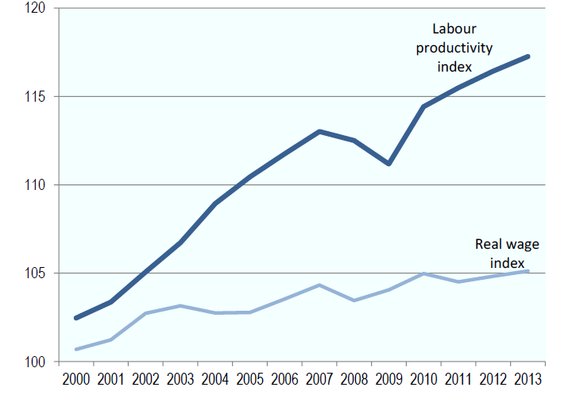
Evolution of average wages & labour productivity in selected G20 economies
Notes:
Source: ILO Global Wage Database; ILO Trends Econometric Models, Apr. 2014.

Slide 11
L2O Tracking of G20 Commitments
November 2015 assessed replies to questionnaire from trade union centres in 17 G20 countries
Followed the first L20 tracking exercise in 2014
That had revealed that the G20 had followed up least the commitments made in 2013 that mattered to union members most

Slide 12
68%
no desired impact on the national level
no concrete policy changes

Slide 13
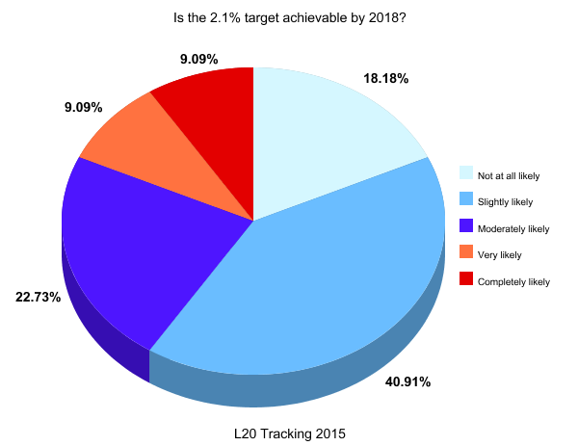
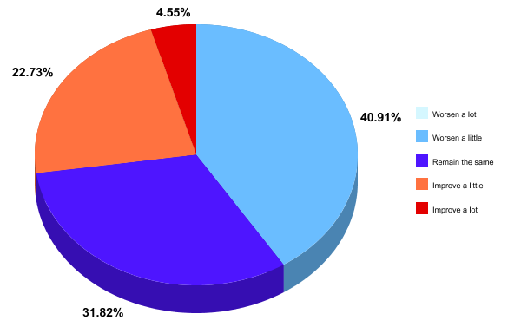
2.1% Growth Target
Only 18% think their country will completely or very likely achieve the goal by 2018
41% expect the economic situation to worsen a little
32% believe that it will remain the same

Slide 14
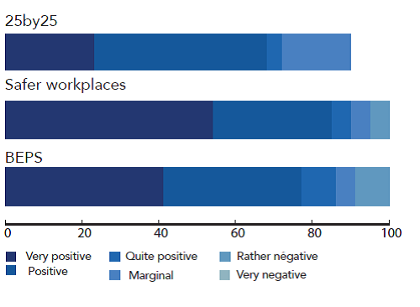
Specific G20 Action Plans fare much better in comparison
Notes:
on average, the three G20 commitments on elevating female labour market participation by 25% by 2025 (25by25), the declaration on Safer Workplaces and the G20/ OECD Base Erosion and Profit Shifting Action Plan were ranked as “rather achievable” at national level
25by25: VP = 23% / P = 45% / QP = 14% / Marginal = 18%
Safer workplaces: VP= 54% / P = 31%/ QP = 5% / M = 5% / Rather negative = 5%
BEPS: VP = 41% / P = 36% / QP = 9%/ M = 5% / RN = 9 %

Slide 15
Spotlight on the 800 commitments
74% said that further commitments need to be made to achieve the 2.1% growth target & improve living conditions for workers
Out of 76 growth policies, “some progress” on implementation in 9 countries, “insufficient progress” in 6 countries on average
Individually: 18% (no progress), 30% (insufficient progress), 40% (some progress) & 12% (strong progress)
62% were perceived as having a positive impact on working families, 19% as “neutral”, 15% “negative” & 4% “highly negative”
Multiple cases of policies being rated as highly positive but showing no progress (and vice versa)
Notes:
In difference to last year (62%)

Slide 16
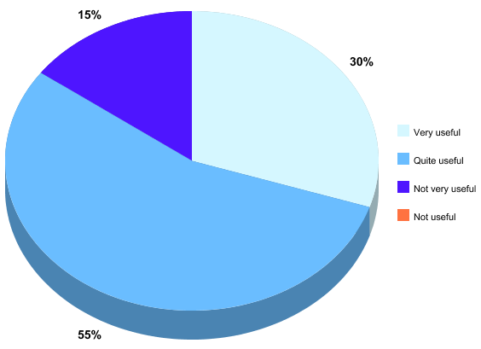
G20 youth target: Very useful (30%) or quite useful (55%)
Notes:
“Taking action against irregular and informal employment” coming out as the only measure considered “extremely important”, followed by “Promoting apprenticeships”, “Facilitating first-time job placement”, “On-the-job training” and “Enabling a variety of educational pathways” (all very important). “Programmes to enhance mobility of young workers” and “Encouraging youth entrepreneurship” were considered to be only moderately important on average.

Slide 17
UNION FOCUS
Ensuring L20 goals (jobs and reducing inequality) are on the “inclusion” agenda and the EWG subgroup and in the outcomes of the joint Labour and Finance Minister meeting
Research and advocacy with a view to promote wage-led growth, collective bargaining coverage, social protection and respect for labour rights (see latest IMF research)
Build on “safe work” G20 statement to engage discussion on decent work and supply chains, and development, by linking to the G7 discussion
Track and influence the infrastructure investment follow up
L20 “tracking” to ensure follow up on G20 commitments on job creation, gender – 25/25, quality apprenticeship
Track BEPS and Tax Evasion follow up

Slide 18
L20 timelines 2016
G20 SHERPAS
G20 LABOUR AND EMPLOYMENT MINISTERS’ MEETING and L20 SUMMIT
G20 EMPLOYMENT WORKING GROUP
February
March
April
May
June
July
August
Sept.
L20 LAUNCH
OECD MINISTERIAL COUNCIL AND FORUM
G20 LEADERS SUMMIT
G20 EMPLOYMENT WORKING GROUP

Slide 19
THANK YOU
谢谢

